Slide 1
Hyperesume
Hyperesume is a full-featured resume builder application designed to help job seekers create professional, customized resumes. By using Hyperesume, users can streamline the resume-building process through a structured, user-friendly interface that enables them to add, edit, and manage various sections of their resumes, such as contact information, education, work experience, skills, and projects.
The application also supports multiple resume templates, allowing users to select a layout that best fits their professional profile. In addition, users can preview and export their resumes as PDFs for easy sharing with potential employers.

Slide 2



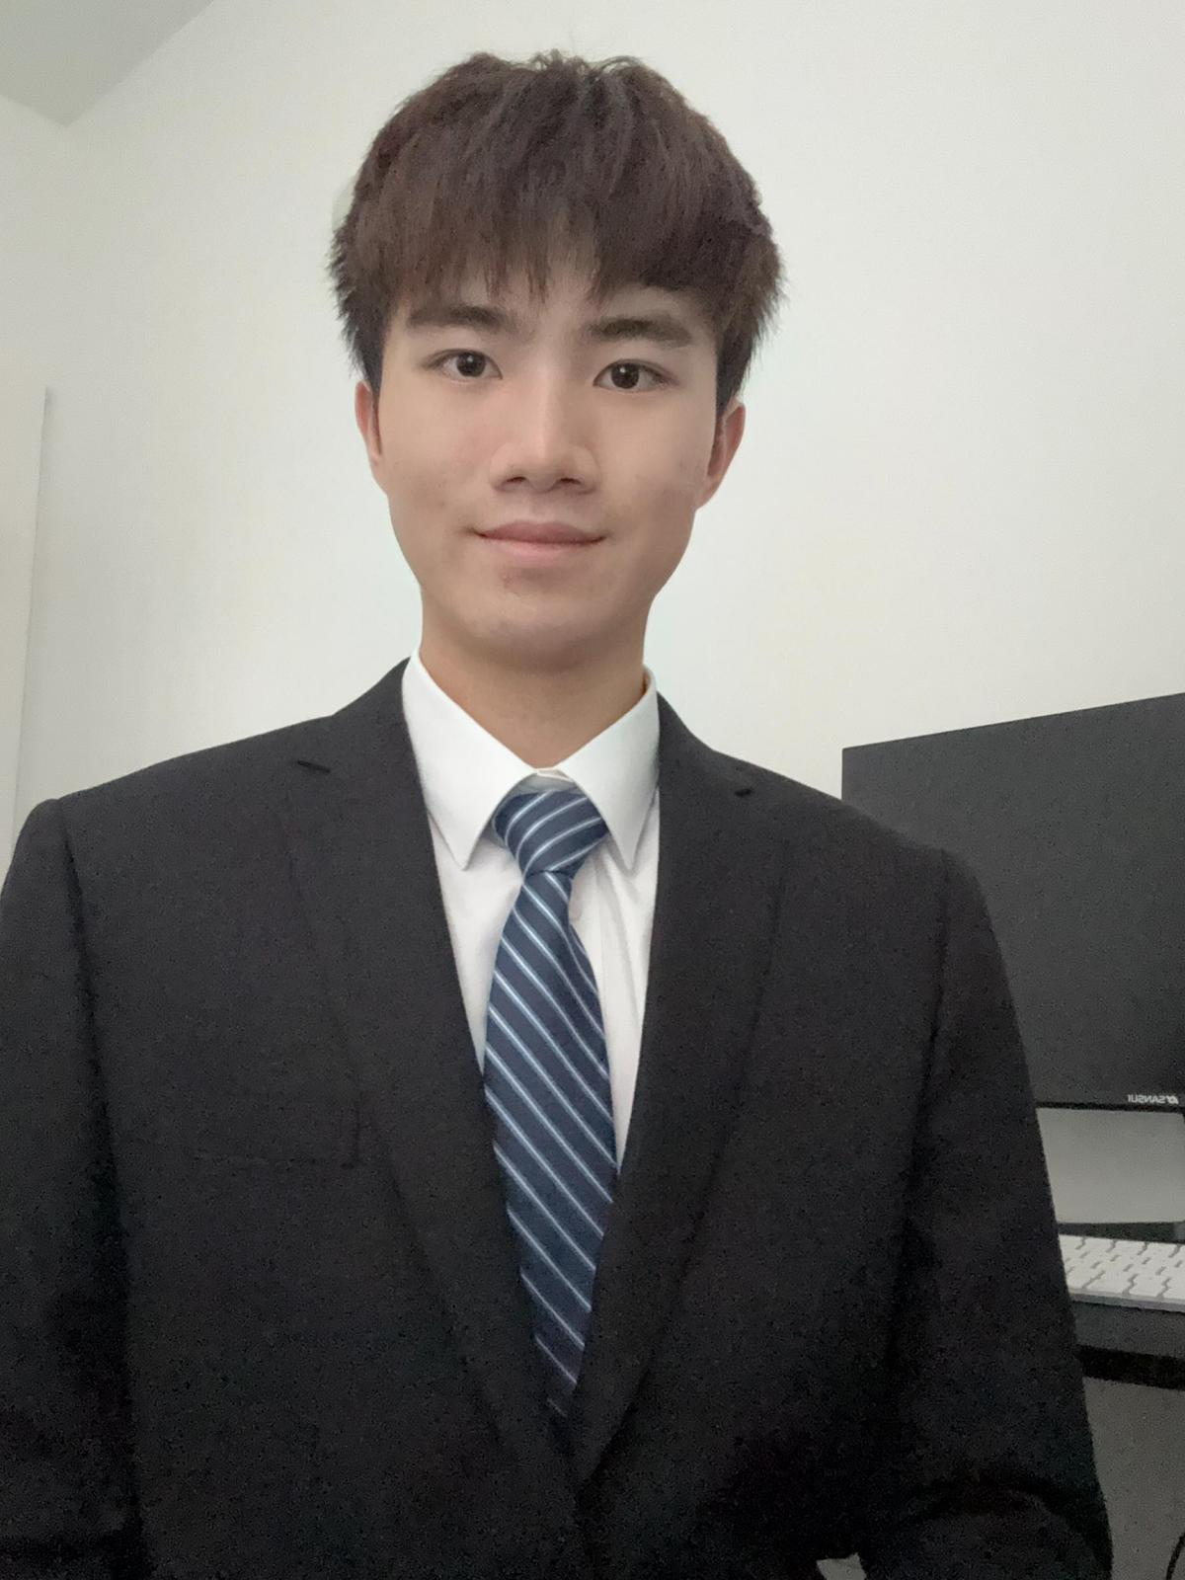

Team
Jianan Ni
NUID: 001029501
Hongyi Gao
NUID: 002793666
Arundhati Bandopadhyaya
NUID: 002313855
Yuyang Wang NUID: 002310874
Jiajun Zheng NUID: 002305427

Slide 3
Technology Stack
Backend: Spring Boot
Frontend: Lucide-react, React Redux
Languages: Java/HTML/CSS
Database: MySQL
ORM/Data Mapper: MyBatis
Build Tool: Maven
Version Control: Git
Additional Libraries:
Jakarta Validation (for input validation)
BCryptPasswordEncoder (for password encryption)

Slide 4
SOLID Principles in Resume Builder API
Single Responsibility Principle
Each controller manages exactly one type of resource (Education, Experience, Skills, etc.)
Clear separation between admin, auth, and user functionalities
Controllers focus solely on handling HTTP requests/responses

Slide 5
SOLID Principles in Resume Builder API
Open/Closed Principle
Controllers are structured to be extended without modification
Base URLs and REST endpoints make versioning and updates easy
New features can be added through new endpoints without changing existing ones

Slide 6
SOLID Principles in Resume Builder API
Liskov Substitution Principle
All controllers follow common REST patterns and behaviors
Consistent response structures across endpoints
Standardized error handling approach

Slide 7
SOLID Principles in Resume Builder API
Interface Segregation Principle
APIs are divided into focused, specific controllers
Each controller exposes only relevant endpoints
Clean separation between different functional areas (auth, admin, user profiles)

Slide 8
SOLID Principles in Resume Builder API
Dependency Inversion Principle
Controllers depend on service interfaces, not implementations
Proper use of dependency injection
Loose coupling between layers

Slide 9
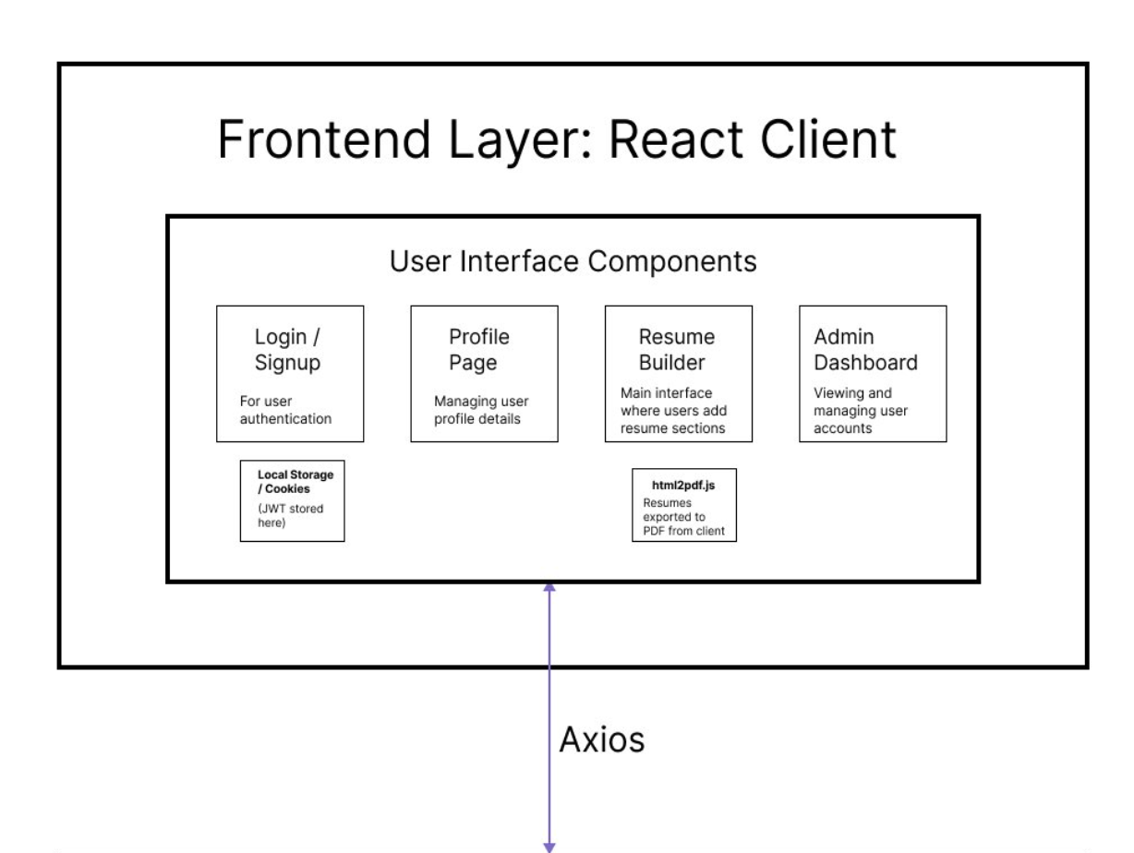
SYSTEM ARCHITECTURE DIAGRAMS

Slide 10
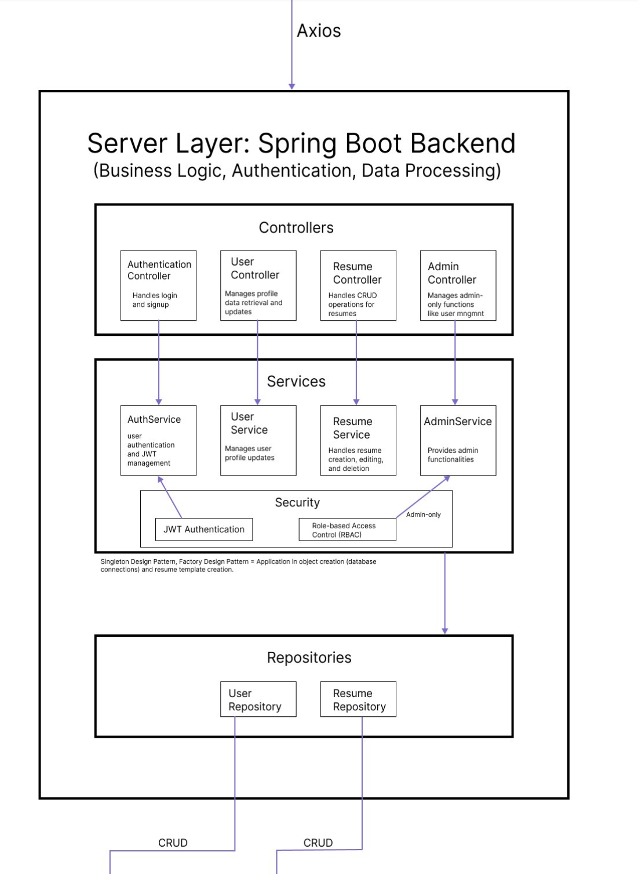
SYSTEM ARCHITECTURE DIAGRAMS

Slide 11
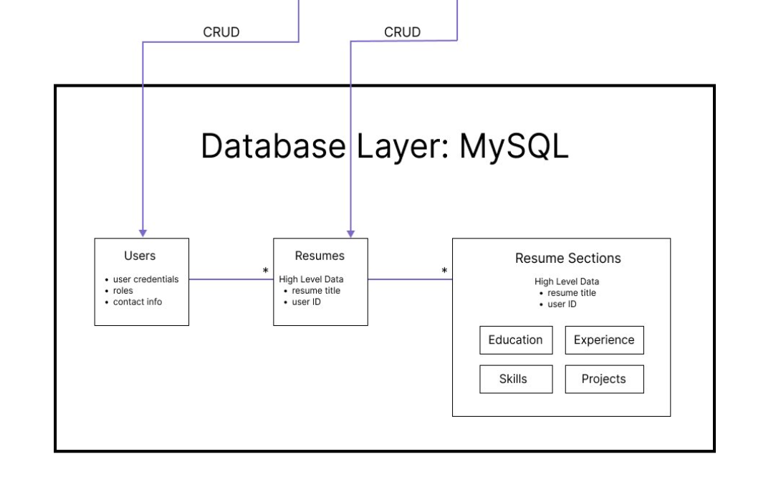
SYSTEM ARCHITECTURE DIAGRAMS

Slide 12

Go through milestone journey

Slide 13
Milestone 1: Foundation and Initial Development
Objective: Create a platform, Hyperesume, for interactive and secure resume creation and management.
Key Concepts Implemented:
Encapsulation: Data encapsulated in classes like User, Profile, and Experience.
Abstraction: Service interfaces separate logic from controllers.
Polymorphism: Interfaces and overridden methods in services and configurations.
Association: User profiles and experiences linked through the userId attribute.
Dependency Injection: Modular services and repositories.
Tech Stack: Spring Boot (Backend), React (Frontend), MySQL (Database), MyBatis (ORM).
Team Achievements:
Team members built login, sign-up features, database tables, APIs for user registration, and resume CRUD operations. Initial frontend and backend integration were also completed.

Slide 14
Milestone 2: Enhanced Functionality and Integration
Key Functionalities:
Responsive frontend design with connected backend and secure sign-in.
Developed homepage, login page, and admin dashboard.
Key Concepts Extended: Encapsulation, Abstraction, Polymorphism, Association reused and expanded.
Tech Updates: Redux added for state management in React; robust security configuration implemented.
Team Achievements:
Focused on bug fixing, resume API testing, admin dashboard editing, and converting static pages to React. Enhanced UI responsiveness and interactivity.

Slide 15
Milestone 3: Final Functionalities and Polishing
Key Functionalities:
User Management: Registration, login, authentication, role-based access.
Profile and Experience Management: Add, edit, delete profiles and experiences.
Resume Management: CRUD for resumes with PDF export.
Admin Dashboard: Manage user accounts and roles.
Responsive design across devices with enhanced error handling and security.
Tech Concepts: Demonstrated advanced Object-Oriented Principles like Singleton Pattern and Custom Exception Handling.
Team Achievements:
Finalized resume templates, improved CSS and authentication, added interactive frontend features like thumbnails and role-based navigation. APIs for preview and saving resumes enhanced functionality.

Slide 16
Future Scope of Hyperesume
AI-Powered Resume Suggestions: Integrate AI to provide personalized resume suggestions, such as optimized phrasing, skill recommendations, or layout enhancements based on industry trends.
Dynamic Templates and Customization: Expand the library of resume templates with more dynamic, interactive designs. Allow users to customize templates by adjusting colors, fonts, and sections dynamically.
Job Application Integration: Enable direct integration with job boards (e.g., LinkedIn, Indeed) to streamline application processes. Provide a one-click application feature linked to the generated resumes.
Skill Validation and Endorsement: Add features for users to validate skills through certifications or endorsements from peers and employers.

Slide 17
Key Takeaways
Understanding Object-Oriented Programming (OOP) Concepts:
Gained hands-on experience implementing core OOP principles like encapsulation, abstraction, polymorphism, inheritance, and association in a real-world application.
Backend Development Mastery:
Built a robust backend using Spring Boot, implementing features such as authentication, role-based access control, and RESTful APIs.
Learned to utilize ORM tools like MyBatis to interact efficiently with databases.
Database Design and Integration:
Designed and optimized relational database schemas.
Used MySQL to store, retrieve, and manipulate application data.
Team Collaboration and Project Management:
Practiced version control using Git and managed project workflows collaboratively.
Balanced individual contributions with team efforts to deliver a cohesive product.

